Slide 1


Shri Ram Murti Smarak College Of Engineering And Technology
Mini Project Presentation
Topic :- Session :- 2023-2023
Department Of Computer Science And Engineering
Presented to :- Presented By:-

Slide 2
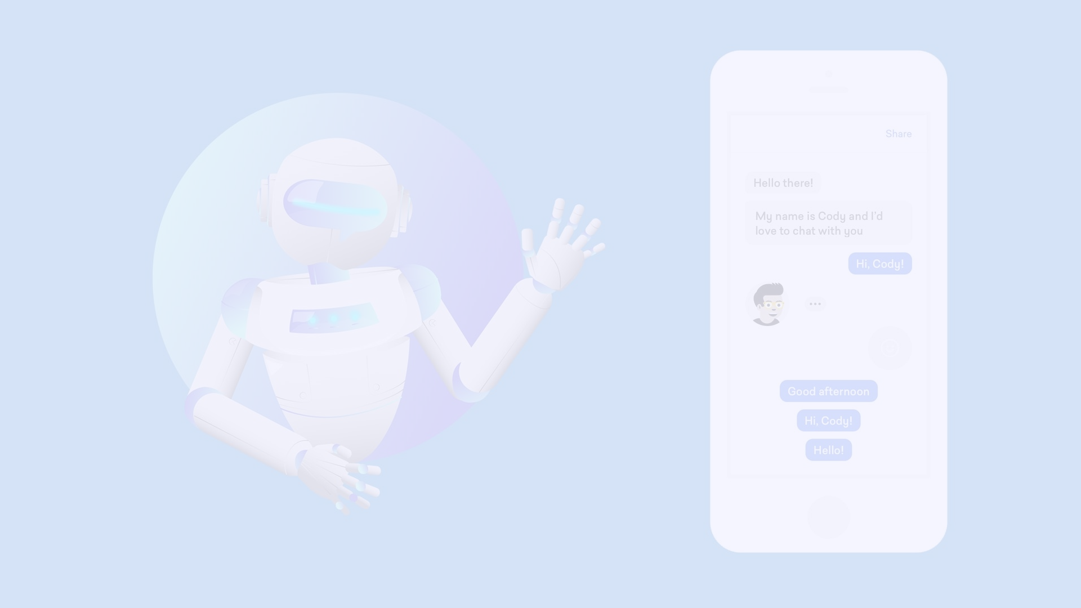
Introduction
A chatbot is an artificial intelligence program designed to simulate human conversation. By leveraging natural language processing and machine learning algorithms, chatbots can interact with users and provide helpful information.
Health tracking has become an essential part of our daily routines. However, the traditional methods of tracking our health can be cumbersome and overwhelming. This is where chatbots come in - they provide a simple and interactive solution to monitoring our well-being.
The objective of this project is to develop a chatbot that can help users easily track and manage their health. Our goal is to provide a user-friendly and efficient system that can help individuals stay on track with their health goals.
The importance of this project lies in the fact that chatbots have the potential to revolutionize the way we approach healthcare. By providing a personalized and accessible platform for monitoring our health, we can improve our overall well-being and prevent potential health issues.

Slide 3

Project Overview
Scope and Limitations
The scope of this project is to develop a chatbot for health tracking using Python, API, and React framework. The chatbot will be able to track various health parameters such as heart rate, sleep, and physical activity. It will also allow users to set health goals and receive reminders and recommendations to help them achieve their goals.
However, there are certain limitations to this project. The chatbot is not intended to replace professional medical advice, and users should always consult with a qualified healthcare provider before making any changes to their health routines. Additionally, the chatbot may not be able to accurately track certain health parameters for all users, as individual factors such as age, weight, and medical history can affect the accuracy of the data.
Brief Description of the Project
The chatbot for health tracking will be developed using Python for the backend, API for data collection and processing, and React for the frontend. The chatbot will be able to communicate with users via a messaging interface and will provide personalized health tracking and management services.

Slide 4
Project Timeline
Phases of the project
Gupta Headings ke hisab se
Or net, synopsis se dekh kr content likh diyo
3-4 pages blank chod diyo
Jo heading samajh na aaye ya shi na lage
Unko last me conclusion ke baad likh diyo
Bs content likha hai baki flowchart 1 hai baki or
Add kr denge bs tu content add kr liyo

Slide 5

BlanK page for futher extension and modification

Slide 6

Design and Architecture
Technical specifications
System architecture
Design considerations
Input
Enter the technical specifications, system architecture, and design considerations here
Context
The other cards in the deck are:
Card 1: [Description]
Card 2: [Description]
Card 3: [Description]

Slide 7
Python as the Base Language for Chatbot Development
Python provides a solid foundation for developing chatbots. With its rich libraries and powerful AI capabilities, Python empowers developers to create intelligent and interactive chatbot applications.
When it comes to training a chatbot, Python offers various machine learning frameworks and libraries such as TensorFlow, PyTorch, and scikit-learn. These libraries enable developers to build and train models for natural language processing and understanding.
Furthermore, Python's support for APIs allows developers to easily fetch data from external sources. By leveraging APIs, chatbots can access and integrate information from different platforms, making them more versatile and valuable.
With Python as the base language and its ability to train chatbots and use APIs for data fetching, developers have a powerful toolkit to create highly functional and intelligent chatbot applications.

Slide 8

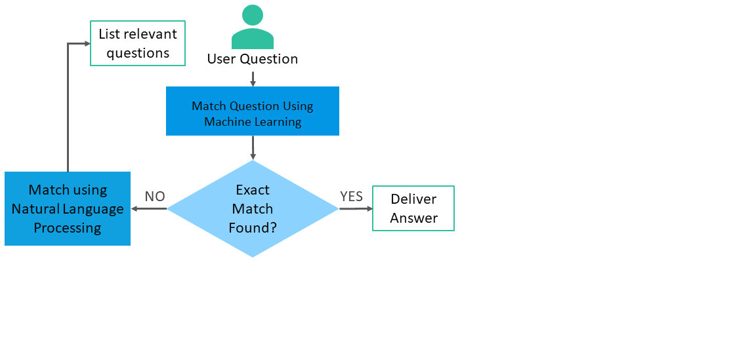

Slide 9

Benefits of Using Chatbots for Health Tracking
Improved Accessibility and Convenience
Real-Time Monitoring and Feedback
Personalized Health Recommendations
By analyzing user data and leveraging AI algorithms, chatbots can offer personalized and tailored health recommendations, providing individuals with valuable insights and guidance.
Chatbots provide a seamless and accessible way for individuals to track their health without the hassle of complex interfaces or appointments.
With chatbots, users can receive instant feedback on their health-related queries or data, enabling them to make informed decisions and take necessary actions promptly.

Slide 10
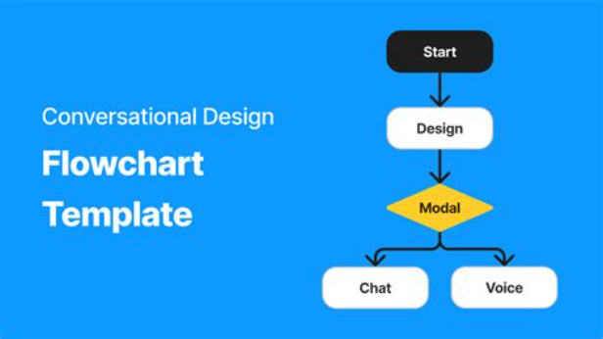
Flow Diagrams and Methodology for Chatbot Development
When building chatbots, it's crucial to have a clear methodology and well-defined flow diagrams. These visual representations help developers understand the chatbot's logic and plan its interactions with users. By following a systematic approach, developers can ensure a smooth user experience and efficient chatbot functionality.

Slide 11

Requirement Analysis
System requirements
Input
Enter the system requirements here
Context
The other cards in the deck are:
Card 1: [Description]
Card 2: [Description]
Card 3: [Description]

Slide 12

Implementation
Development Process
Our development process is based on agile methodologies. We follow a sprint-based approach with daily standups, sprint planning and review meetings. This helps us stay on track and deliver high-quality software on time.
Coding Practices
We follow industry-standard coding practices like code reviews, unit testing, and continuous integration. We also use linters and automated testing tools to maintain code quality and consistency.
Tools and Technologies Used
We use a variety of tools and technologies to develop our software, including:
Programming languages: Java, Python, JavaScript
Frameworks and libraries: Spring, React, Angular
Database technologies: MySQL, MongoDB, Redis
DevOps tools: Docker, Kubernetes, Jenkins
Input
Enter the implementation details here
Context
The other cards in the deck are:
Card 1: [Description]
Card 2: [Description]
Card 3: [Description]

Slide 13

Challenges and Solutions
Issues Faced During the Project
Throughout the project, we encountered several challenges that required careful consideration and problem-solving. Some of the key issues we faced include:
Limited resources and tight deadlines
Complex requirements and changing scope
Technical difficulties and integration problems
Solutions or Workarounds Implemented
To overcome these challenges, we implemented the following solutions and workarounds:
Optimized resource allocation and prioritization
Regular communication and collaboration with stakeholders
Thorough testing and debugging processes
Input
Enter the challenges and solutions here
Context
The other cards in the deck are:
Card 1: [Description]
Card 2: [Description]
Card 3: [Description]

Slide 14
Results and Achievements
Project Outcomes
Our project has achieved the following outcomes:
[Project Outcome 1]
[Project Outcome 2]
[Project Outcome 3]
Key Achievements
Some of the key achievements of our project include:
[Key Achievement 1]
[Key Achievement 2]
[Key Achievement 3]
Performance Metrics
We have measured the performance of our project using the following metrics:
[Performance Metric 1]: [Value]
[Performance Metric 2]: [Value]
[Performance Metric 3]: [Value]
Input
Enter the results and achievements here
Context
The other cards in the deck are:
Card 1: [Description]
Card 2: [Description]
Card 3: [Description]

Slide 15

Conclusion
Chatbots have the potential to revolutionize health tracking by making it more convenient, accessible, and personalized. With advancements in AI and frameworks like Python API and React, the future of chatbots in health monitoring looks promising.

